Slide 1

Predictive Modelling

Slide 2
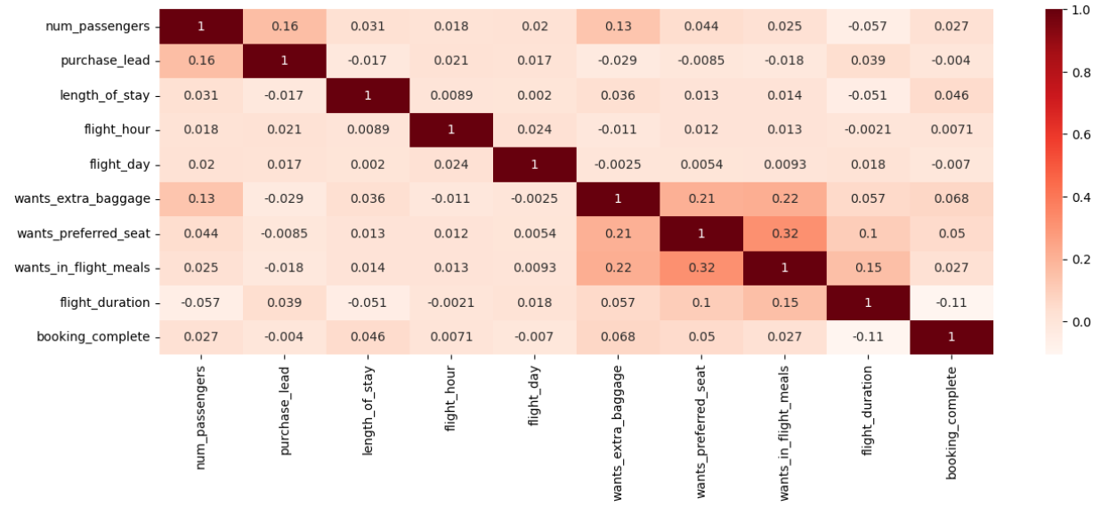
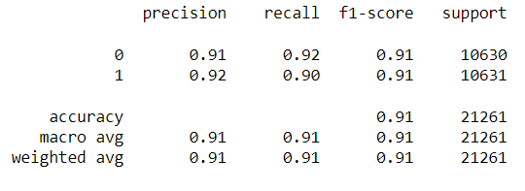
Exploratory Data Analysis:
Majority of the flight days are Monday, and the minority are Sunday
Significantly large amount of people book their flight as round-trip
Most of the booking origins are from Australia
Features and Correlations:
With highest correlation (0.32), passengers who want preferred seats are positively corelated to passengers who want in-flight meals.
Additionally, passengers who want extra baggage are correlated with passengers who want in-flight meals (0.22) and passengers who want preferred seat (0.21)
From the correlations, exploratory data analysis and modelling, in-flight features are significantly important when it comes to booking a flight with British Airways. These features include wanting extra baggage, wanting preferred seat, and wanting in-flight meals.
Measures taken prior to Modelling:
Getting dummy variables for categorical variables
Capping outliers with upper/lower limits
Using SMOTE to avoid overfitting
Random Forest Evaluation:
Accuracy: 91% , F1-score: 0.91
K-Fold Cross Validation: [0.90, 0.91, 0.91, 0.91, 0.91]
The model has consistent performance across different subsets of the data
Result: the model is acceptable with high consistent accuracy

